Slide 1
Authorship Identification
Name: Da Eun Kim Supervisor: Mark Stevenson

Slide 2
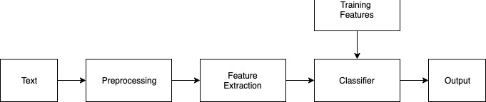
Prototype
Overview of system

Slide 3
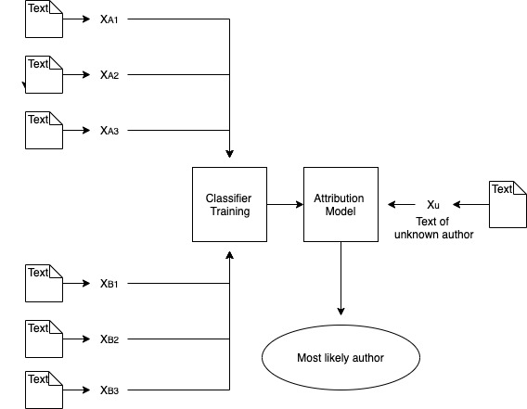
Instance-based Approach

Slide 4
Feature extraction
Continuous n-gram
Continuous Word n-gram
Continuous Character n-gram
Continuous Word and Character n-gram

Slide 5
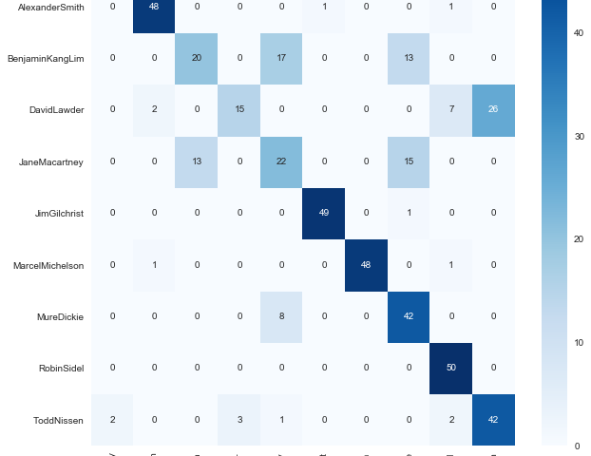
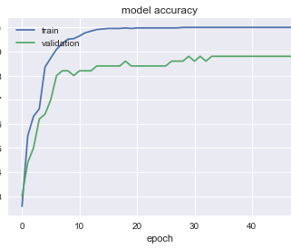
Evaluation
Model accuracy &Confusion matrix

Slide 6
Conclusion
Accuracy
Continuous n-grams | 2-grams word/char | 3-grams word/char | 4-grams word/char | Word and character 4-grams
CCAT10 | 0.754/ 0.722 | 0.738/0.760 | 0.760/0.766 | 0.772
CCAT50 | 0.661/ | 0.642/ | /0.705

Slide 7
Thank you

